Slide 1
RATE OF CHANGE

Slide 2
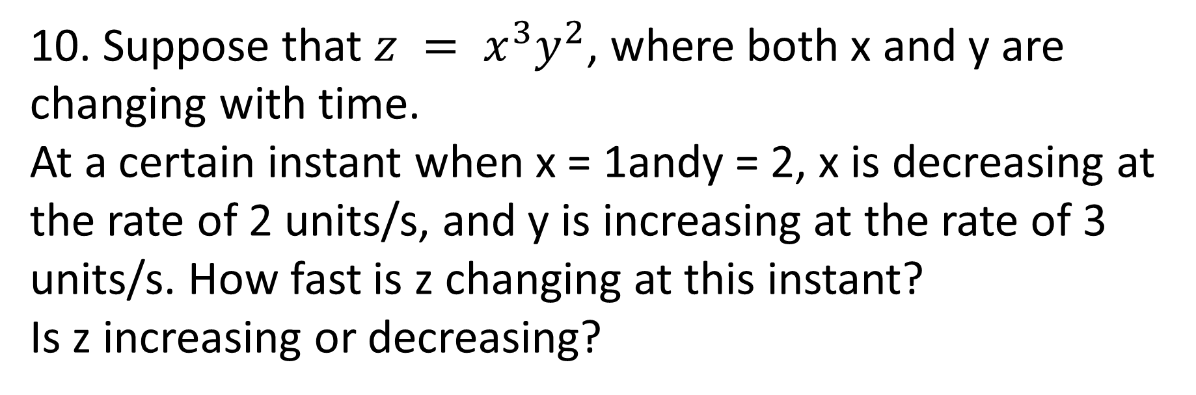
10. Suppose that $z = x^{3}y^{2}$, where both x and y are changing with time.
At a certain instant when x = 1andy = 2, x is decreasing at the rate of 2 units/s, and y is increasing at the rate of 3 units/s. How fast is z changing at this instant?
Is z increasing or decreasing?

Slide 3




we differentiate 'z' with respect to the time.Here,we differentiate it by multiplication method:
Given that when x =1 ,x is decreasing at the rate of 2units /s
It implies that
when y =2,y is increasing at the rate of 3units/s
Z change at this instant:-
Z is decreasing

Slide 4
The minute hand of a certain clock is 4 in long. Starting
from the moment when the hand is pointing straight up,
how fast is the area of the sector that is swept out by the
hand increasing at any instant during the next revolution of
the hand?
Solution:

Slide 5



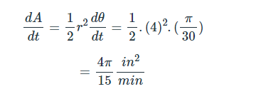


Area of sector:
G$iven :r=4 units and$
Taking diff w.r.t t

Slide 6
Q1: A small rock is dropped into a lake. Circular ripples spread over the surface of the water, with the radius of each circle increasing at the rate of 3/2 ft per second. Find the rate of change of the area inside the circle formed by a ripple at the instant the radius is 4 ft.

Slide 7

Solution: As shown in Figure 18, the area A and the radius r are related by
$A =πr^{2}$.
Both A and r are functions of the time t in seconds. Take the derivative of both sides with respect to time.

Slide 9
Q2: A rock is thrown into a still pond. The circular ripples move outward from the point of impact of the rock so that the radius of the circle formed by a ripple increases at the rate of 2
ft per minute. Find the rate at which the area is changing at the instant the radius is 4 ft.

Slide 10
Q3: A spherical snowball melts in such a way that the instant at which its radius is 20 cm, its radius is decreasing at 3 cm/min. At what rate is the volume of the ball of snow changing at that instant?

Slide 11
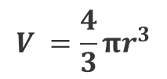
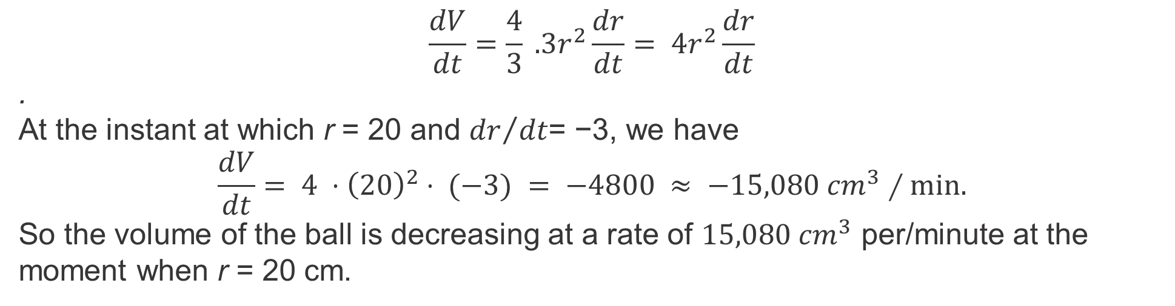

Solution: Since the snowball is spherical, we again have that
$$V =\frac{4}{3}πr^{3}$$
We can no longer write a formula for r in terms of t, but we know that
$$\frac{dr}{dt}= −3 when r = 20.$$
We want to know dV ∕dt when r = 20. Think of r as an (unknown) function of t and differentiate
the expression for V with respect to t using the chain rule:
$$\frac{dV}{dt}=\frac{4}{3} .3r^{2}\frac{dr}{dt}= 4r^{2}\frac{dr}{dt}$$
.
At the instant at which r = 20 and ${dr}/{dt}$= −3, we have
$$\frac{dV}{dt}= 4 ⋅{\left(20\right)}^{2}⋅ (−3) = −4800 ≈ −15,080 cm^{3}∕min.$$
So the volume of the ball is decreasing at a rate of $15,080 cm^{3}$ per/minute at the moment when r = 20 cm.

Slide 12
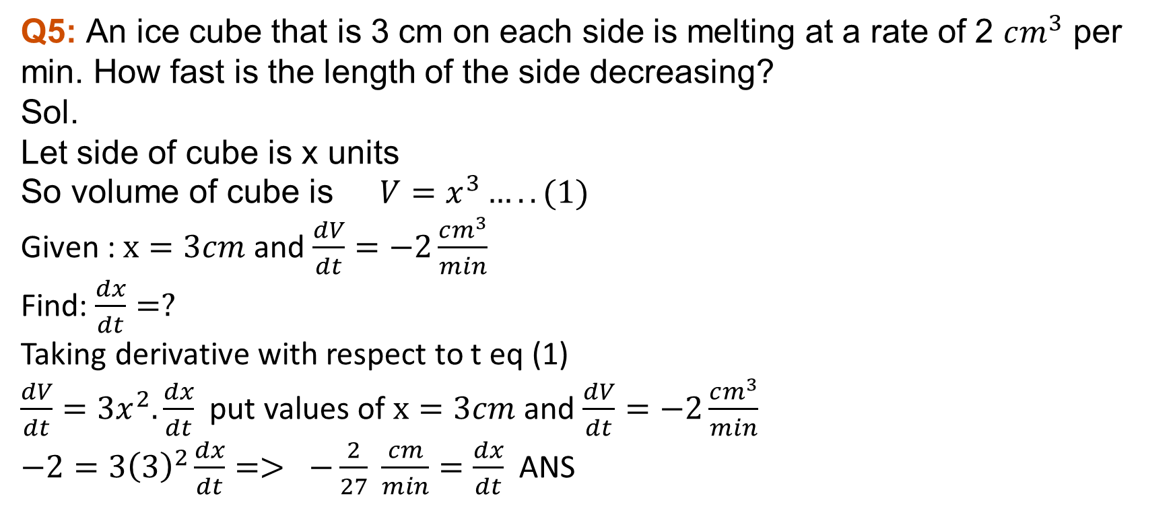
Q4: Air is being pumped into a spherical balloon at a rate of 5 cm³/min. Determine the rate at which the radius of the balloon is increasing when the diameter of the balloon is 20 cm.
Q5: An ice cube that is 3 cm on each side is melting at a rate of 2 $cm^{3}$ per min. How fast is the length of the side decreasing?
Sol.
Let side of cube is x units
So volume of cube is $V=x^{3}…..(1)$
Given : $x=3cm$ and $\frac{dV}{dt}=−2\frac{cm^{3}}{min}$
Find: $\frac{dx}{dt}=?$
Taking derivative with respect to t eq (1)
$\frac{dV}{dt}=3x^{2}.\frac{dx}{dt}$ put values of $x=3cm$ and $\frac{dV}{dt}=−2\frac{cm^{3}}{min}$
$−2=3{\left(3\right)}^{2}\frac{dx}{dt}=> −\frac{2}{27} \frac{cm}{min}=\frac{dx}{dt}$ANS

Slide 13
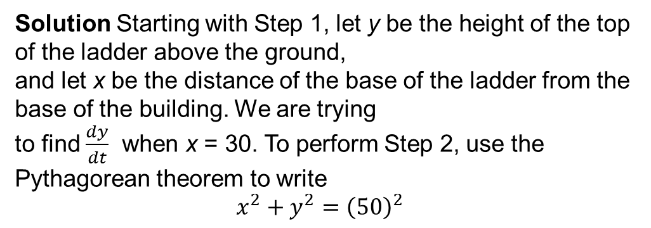
Q6:A 50-ft ladder is placed against a large building. The base of the ladder is resting on an oil spill, and it slips (to the right in Figure 19) at the rate of 3 ft per minute. Find the rate of change of the height of the top of the ladder above the ground at the instant when the base of the ladder is 30 ft from the base of the building.
Solution Starting with Step 1, let y be the height of the top of the ladder above the ground,
and let x be the distance of the base of the ladder from the base of the building. We are trying
to find $\frac{dy}{dt}$ when x = 30. To perform Step 2, use the Pythagorean theorem to write
$$x^{2}+y^{2}={\left(50\right)}^{2}$$

Slide 14
Both x and y are functions of time t (in minutes) after the moment that the ladder starts slipping. According to Step 3, take the derivative of both sides of Equation ( with respect to time, getting
To complete Step 4, we need to find the values of x, y, and dx/dt. Once we find these, we can substitute them into Equation (3) to find dy/dt. Since the base is sliding at the rate of 3 ft per minute,

Slide 15
Also, the base of the ladder is 30 ft from the base of the building, so x = 30. Use this to find y.
At the instant when the base of the ladder is 30 ft from the base of the building, the top of
the ladder is sliding down the building at the rate of 2.25 ft per minute. (The minus sign shows
that the ladder is sliding down, so the distance y is decreasing.)*

Slide 16
Ex#2.8 Q 10 to 20 and Example # 1 to 5.

